Slide 1
Smart Study Planner
CAPSTONE PROJECT
Presented By:
Student Name- Uditya Pal
College Name- Galgotias University
Department- School of Computer Science and Technology

Slide 2
OUTLINE
Problem Statement (Should not include solution)
System Development Approach (Technology Used)
Algorithm & Deployment (Step by Step Procedure)
Result
Conclusion
Future Scope(Optional)
References

Slide 3
Problem Statement
Students and individuals often struggle with a lack of an easy-to-use digital platform to effectively manage their academic and personal tasks. Many existing solutions are either too complex and feature-heavy or lack essential functionalities for effective planning. This leads to disorganized schedules, missed deadlines, and increased stress.
There is a clear need for a lightweight, visually appealing, and user-friendly web application that helps individuals:
Organize and track tasks by subject, priority, and due date.
Visualize their workload with an intuitive timeline and a clear progress bar.
Stay motivated and on track with reliable reminders and an engaging interface.

Slide 4
System Approach
Frontend Technologies:
HTML5 – Structure of the webpage
CSS3 – Styling and responsive layouts
JavaScript – Dynamic interactivity (cart, filtering, total calculation)
Design Approach:
Clean and user-friendly interface
Mobile-responsive design
Modular separation of HTML, CSS, and JS files

Slide 5
Algorithm & Deployment
Product Catalog Creation
Define product categories and details (image, price, description).
Frontend Design
Layout using HTML and CSS (grid & cards).
Interactive Features
Add-to-Cart, Remove-from-Cart functions in JavaScript.
Real-time total price calculation.
Product filtering by category.
Modal views for product details.
Testing
Cross-browser compatibility
Mobile responsiveness
Deployment
Host using GitHub Pages / Netlify for free and easy access.

Slide 6
Links:
Attach your Github link- https://github.com/Uditya-Pal-1/Smart-Study-Planner
LinkedIn Link : https://www.linkedin.com/in/udityapal
Deployed Website Link : smart-study-planner-bay.vercel.app

Slide 7
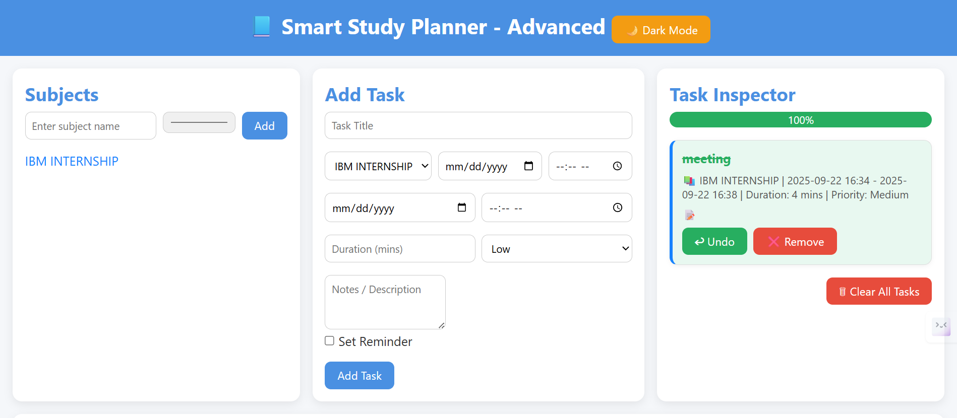
Result

Slide 8
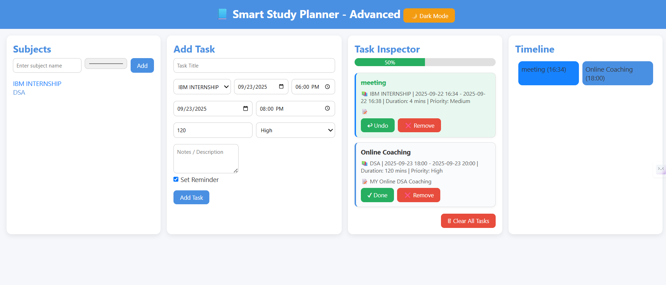
Result

Slide 9
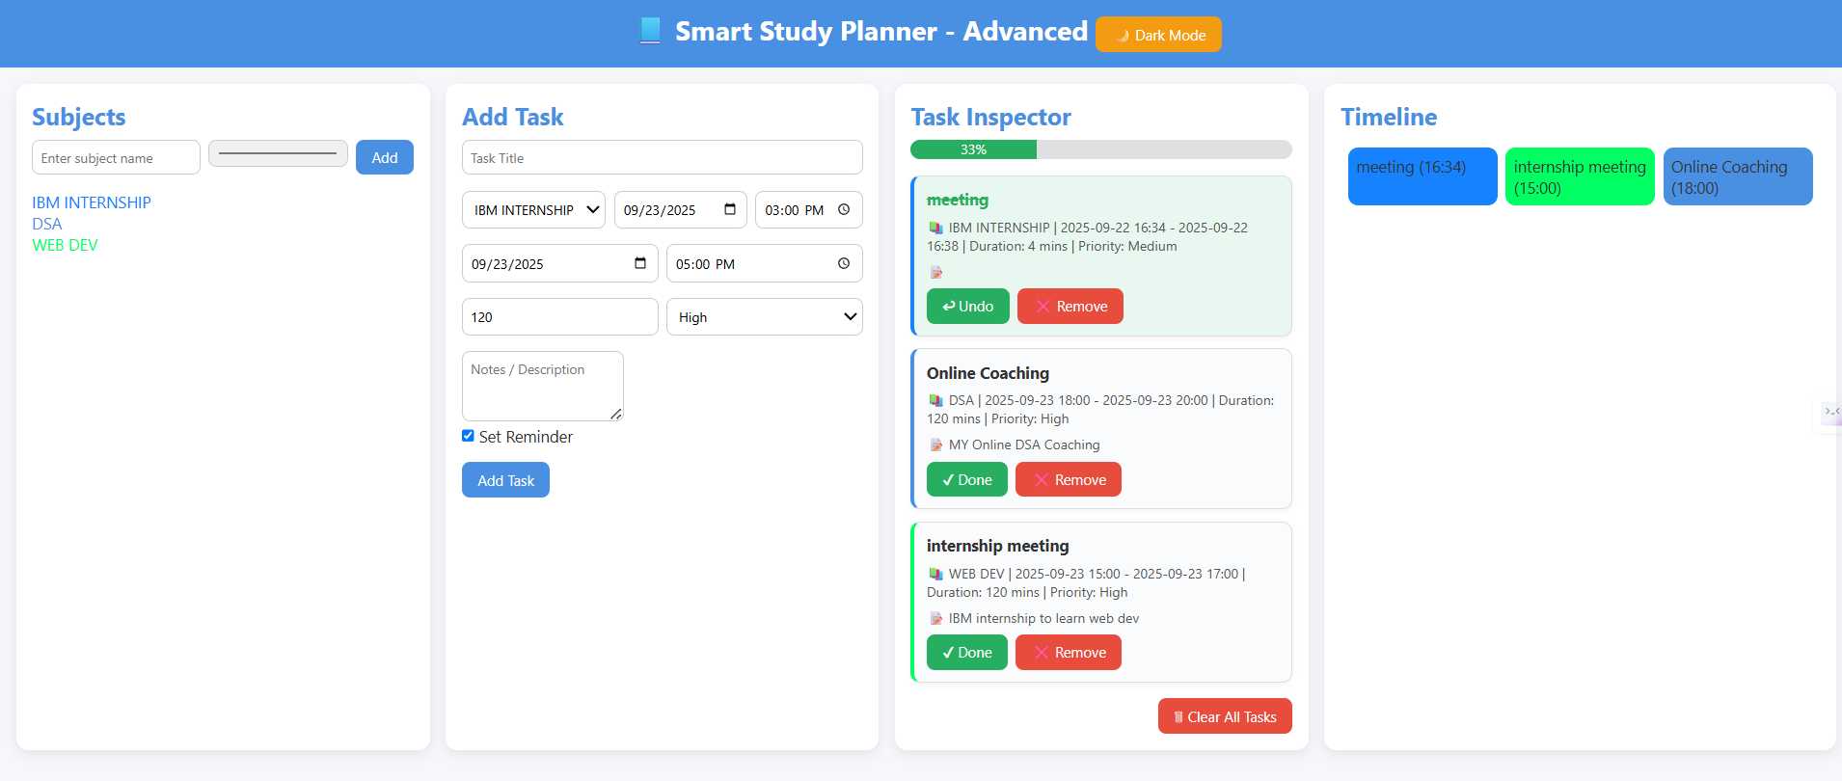
Result

Slide 10
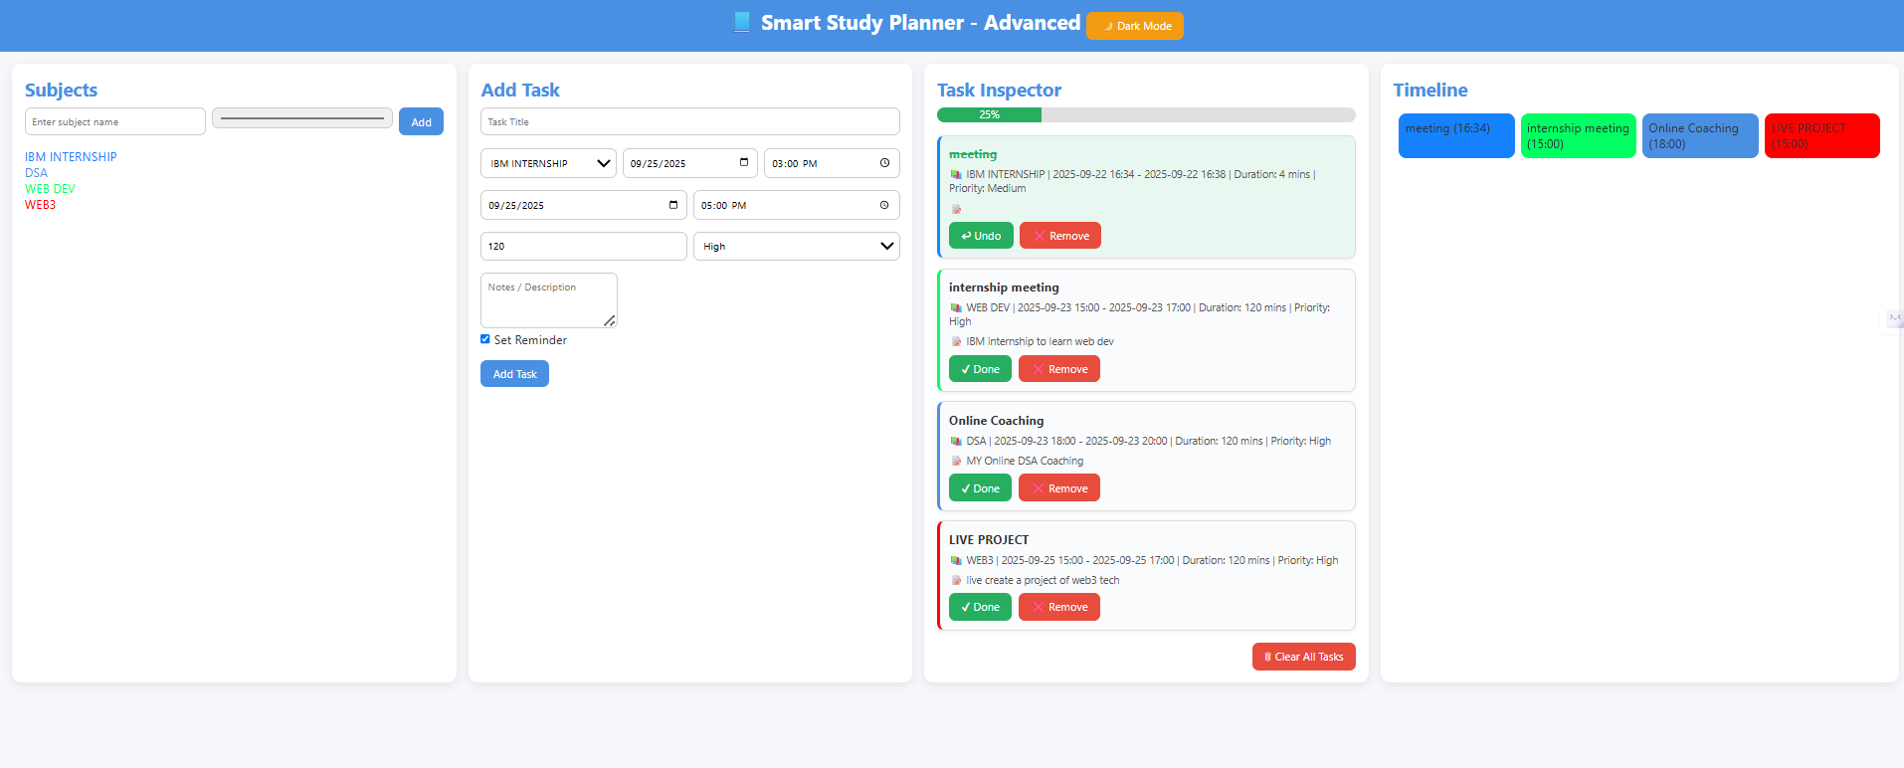
Result

Slide 11
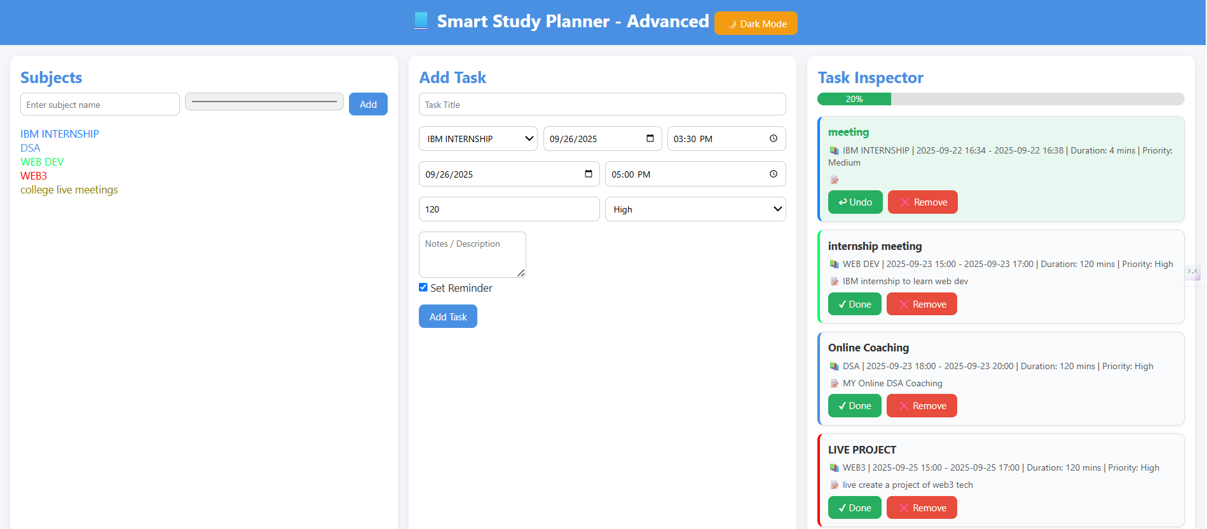
Result

Slide 12
Conclusion
The Smart Study Planner successfully addresses the common challenges students face with organization, task management, and procrastination.
By leveraging a lightweight, frontend-only architecture with HTML, CSS, and JavaScript.
the application provides a cost-effective and accessible solution without the need for complex backend infrastructure or user accounts.
The core strength of the planner lies in its intuitive design and data persistence through localStorage.
Users can effortlessly create, prioritize, and manage tasks, while the dynamic progress bar and interactive timeline provide clear visual feedback on their workload and productivity. The drag-and-drop feature and audible reminders enhance the user experience, transforming a static to-do list into a dynamic and engaging tool.

Slide 13
Future scope(Optional)
The future of this project is to transform it from a local, single-user application into a robust, cloud-based platform. Key areas for expansion include:
User Accounts & Data Sync: Add user authentication with a service like Firebase to allow users to access their tasks from any device.
Recurring Tasks & Subtasks: Implement features for tasks that repeat and allow users to break down projects into smaller, manageable sub-items.
AI-Powered Scheduling: Use machine learning to analyze user habits and intelligently suggest optimal study times and task prioritization.
Real-time Notifications: Integrate browser-based push notifications to send reminders even when the app is not open.

Slide 14
References
List and cite relevant sources, research papers, and articles that were instrumental in developing the proposed solution.
MY Portfolio- https://uditya-pal-1.github.io/portfolio/

Slide 15
THANK YOU

